Slide 1

Vehicle Price Prediction System
An end-to-end machine learning system that accurately predicts vehicle prices based on various features, delivering production-ready insights for buyers and dealers.
Notes:
1

Slide 2
System Performance
90.8%
<50ms
4,000+
15+
R² Score
Inference Time
Vehicle Records
Features
High accuracy on test data
Lightning-fast predictions
Comprehensive training dataset
Rich data attributes analyzed
The system delivers exceptional business value: helps buyers make informed decisions, assists dealers in competitive pricing, provides market insights, and automates valuation processes.
Notes:
2

Slide 3

Multi-Layer Architecture
Frontend Layer
Streamlit dashboard and web UI for user interaction
API Layer
FastAPI with REST endpoints, validation, CORS, rate limiting, and health checks
Business Logic
VehiclePricePredictor, data validation, feature engineering, and error handling
ML Models
XGBoost, LightGBM, CatBoost, and Random Forest ensemble
Monitoring
Prometheus metrics, structured logging, performance tracking, and error reporting
Tech Stack: Python 3.9+, FastAPI, Streamlit, scikit-learn, XGBoost, Docker
Notes:
3

Slide 4

Robust Data Pipeline
Data Sources
Multiple CSV datasets with vehicle information
4,000+ vehicle records
15+ features including make, model, year, mileage
Processing Steps
Data Loading: Multi-file support, automatic schema detection, missing value handling
Feature Engineering: Vehicle age calculation, log transformations, categorical encoding, standard scaling
Data Splitting: Training (70%), Validation (15%), Test (15%), stratified by price ranges
Notes:
4

Slide 5





Machine Learning Models
Ensemble Approach
Model
R² Score
MAE (₹)
Training Time
XGBoost
90.8%
₹45,234
12.3s
LightGBM
89.2%
₹48,567
8.1s
CatBoost
88.9%
₹49,123
15.7s
Random Forest
87.5%
₹52,890
18.4s
Vehicle Year
Engine Capacity
Brand Reputation
32% feature importance
18% feature importance
15% feature importance
Kilometers Driven
Fuel Type
12% feature importance
9% feature importance
Hyperparameter optimization via RandomizedSearchCV with 50 iterations, 3-fold cross-validation, and GPU acceleration support.
Notes:
5

Slide 6


Comprehensive Model Performance
Overall Metrics
Performance by Price Range
Price Range
Samples
MAE (₹)
R² Score
Budget (<3L)
35%
₹28,450
0.887
90.8%
Mid-Range (3-7L)
42%
₹52,120
0.925
Premium (7-15L)
18%
₹89,340
0.891
Luxury (>15L)
5%
₹145,670
0.852
R² Score
Excellent predictive power
8.3%
MAPE
Mean absolute percentage error
MAE: ₹45,234 (average error)
RMSE: ₹67,891 (root mean square error)
Best performance on mid-range vehicles with consistent accuracy across all price segments and strong generalization to unseen data.
Notes:
6

Slide 7
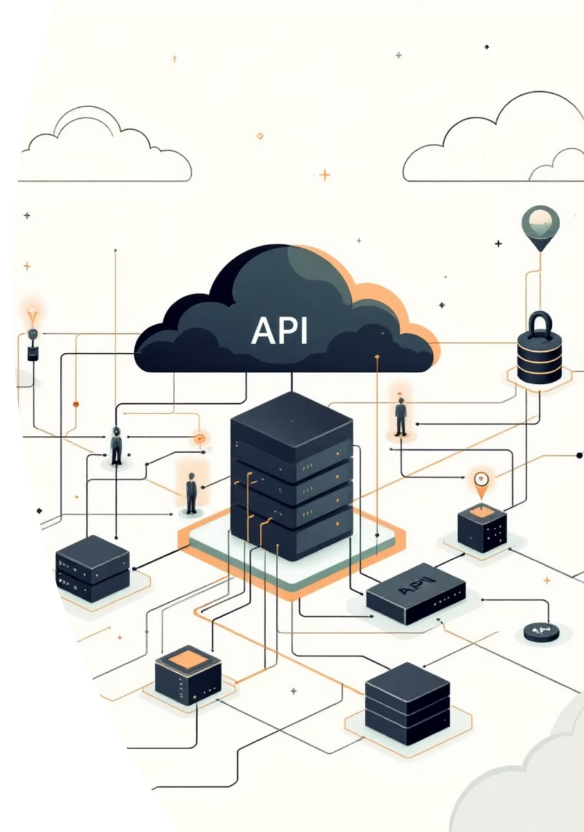
Production Deployment
FastAPI REST API
Endpoints
Features
POST /predict - Single prediction
Request validation with Pydantic
POST /predict/batch - Batch predictions
CORS support for cross-origin requests
GET /health - Health check
Rate limiting to prevent abuse
GET /model/info - Model information
Comprehensive error handling
GET /metrics - Prometheus metrics
API documentation (OpenAPI/Swagger)
Docker
Local
docker-compose up
uvicorn api_app:app --reload
Cloud
AWS/Azure/GCP ready
Performance: 50ms average response time, 200+ req/sec throughput
Notes:
7

Slide 8





Interactive Dashboard
Price Prediction Interface
Easy-to-use form inputs, real-time predictions, confidence indicators, and price category classification
Data Visualization
Price distribution charts, feature importance plots, model comparison graphs, and historical trends
Batch Processing
CSV file upload, bulk predictions, results export, and summary statistics
Model Insights
Performance metrics, feature contributions, prediction explanations, and data quality checks
Access: streamlit run streamlit_app.py → http://localhost:8501
Notes:
8

Slide 9
Production-Grade Quality
Testing Strategy
Code Quality Tools
85%+ code coverage across all test types
Black: Code formatting (PEP 8 compliant)
Flake8: Linting and style checking
Test Type
Tests
Status
isort: Import organization
Unit Tests
25
✅ Pass
mypy: Type checking
pylint: Code analysis
Integration Tests
12
✅ Pass
Security & Monitoring
API Tests
8
✅ Pass
Input validation and sanitization
Performance Tests
5
✅ Pass
Environment-based configuration
Structured JSON logging
Prometheus metrics collection
Notes:
9

Slide 10
Getting Started
01
02
Clone and Navigate
Install Dependencies
cd Vehicle-Price-Prediction
pip install -r requirements.txt
03
04
Process Data
Train Model
python data/dataloader.py --dataset_dir dataset/
python train.py
05
06
Start API
Launch Dashboard
uvicorn api_app:app --reload
streamlit run streamlit_app.py
Next Steps for Production
1
2
Enhance Model
Scale Infrastructure
Add more data sources, implement ensemble methods, fine-tune hyperparameters, add feature interactions
Deploy to cloud (AWS/Azure/GCP), set up load balancing, add caching layer (Redis), implement auto-scaling
3
4
Monitor & Improve
Business Integration
Set up dashboards (Grafana), implement A/B testing, track model drift, continuous retraining
Connect to databases, add authentication, integrate with CRM, generate reports
Notes:
10

